Slide 1



MPC Trajectory Tracking for Drone Navigation
AROB Final Assignment
Alberto Zafra Navarro (876628) – Daniel Sanz Valtueña (795063)
MRGCV
Escuela de Ingeniería y Arquitectura
2023-2024
AROB Final Assignment
Alberto Zafra
Daniel Sanz

Slide 2
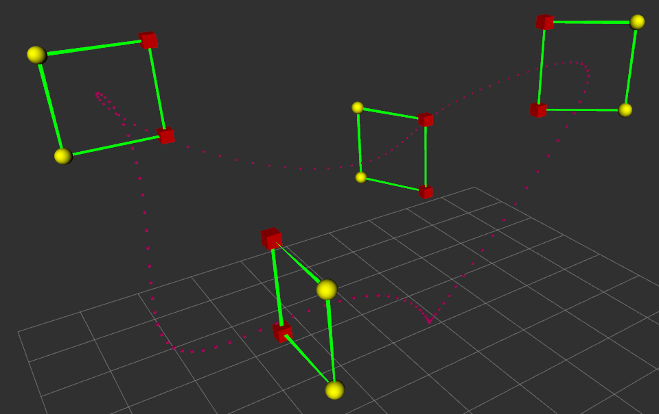
Model Predictive Control (MPC)
Control strategy for dynamic systems
Optimize control actions
Predict future over a lookahead horizon
Designed dartboard target
AROB Final Assignment
Alberto Zafra
Daniel Sanz
Notes:
Decir que todo eso es para:
Trajectory tracking
Ensure input smoothness

Slide 3
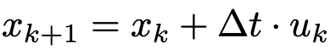
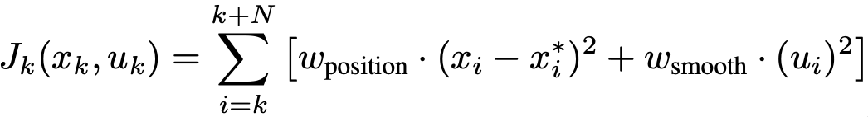
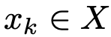
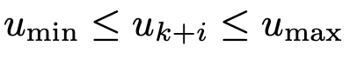
Algorithm description
System dynamics:
Cost function:
Control constraints:
;
AROB Final Assignment
Alberto Zafra
Daniel Sanz
Notes:
Prediction Model: MPC uses the first order dynamic model of the system to predict future states over a specified prediction horizon
Optimization: At each time step, it solves an optimization problem to determine the control inputs that minimize a cost function subject to system dynamics and constraints
Control constraints:

Slide 4
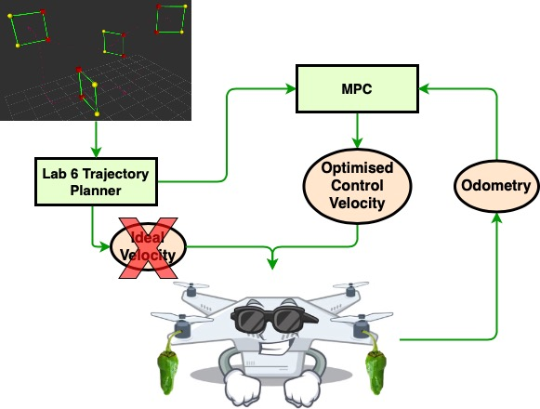

Implementation details
Illustration graph of the quadrotor control system
AROB Final Assignment
Alberto Zafra
Daniel Sanz

Slide 5
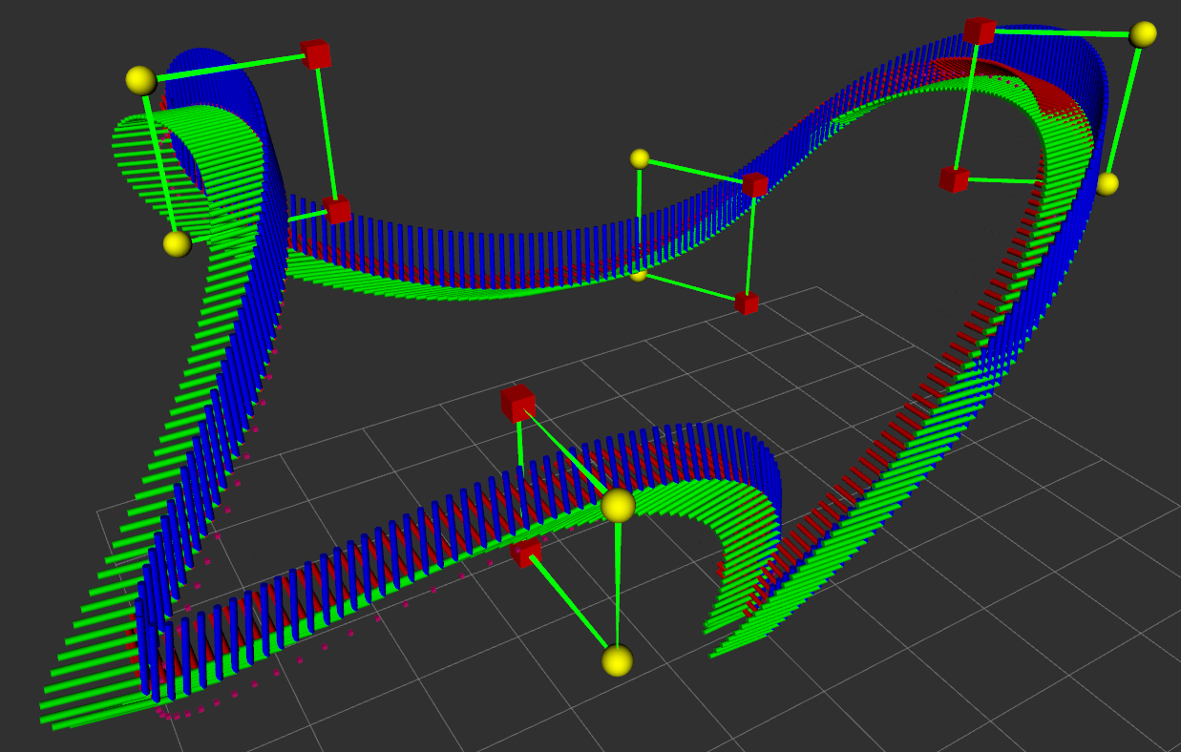
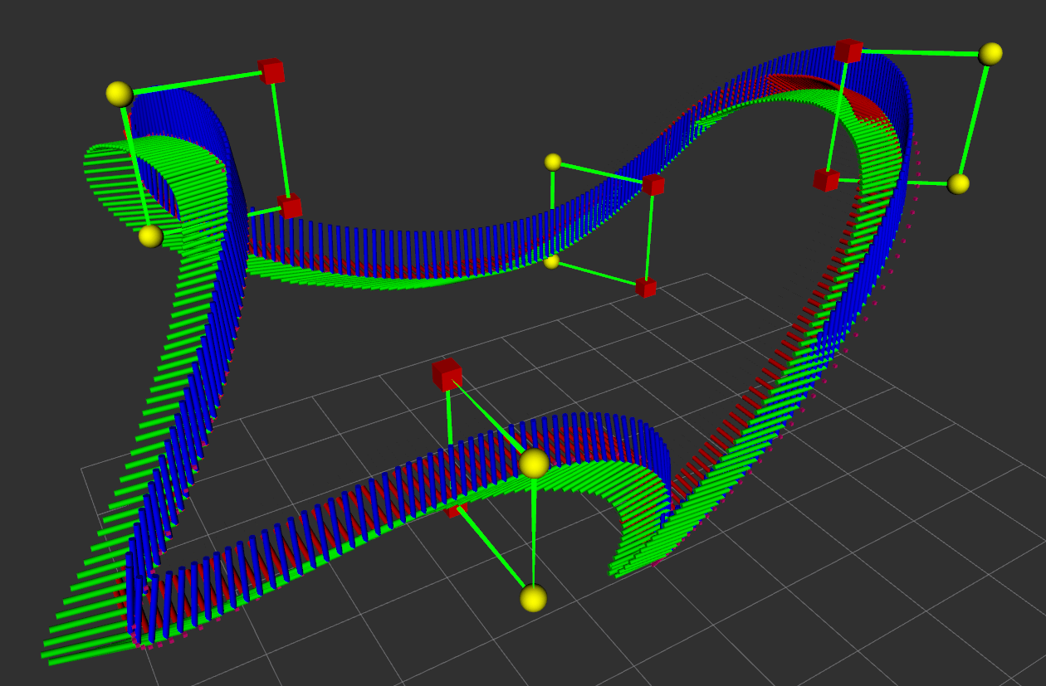
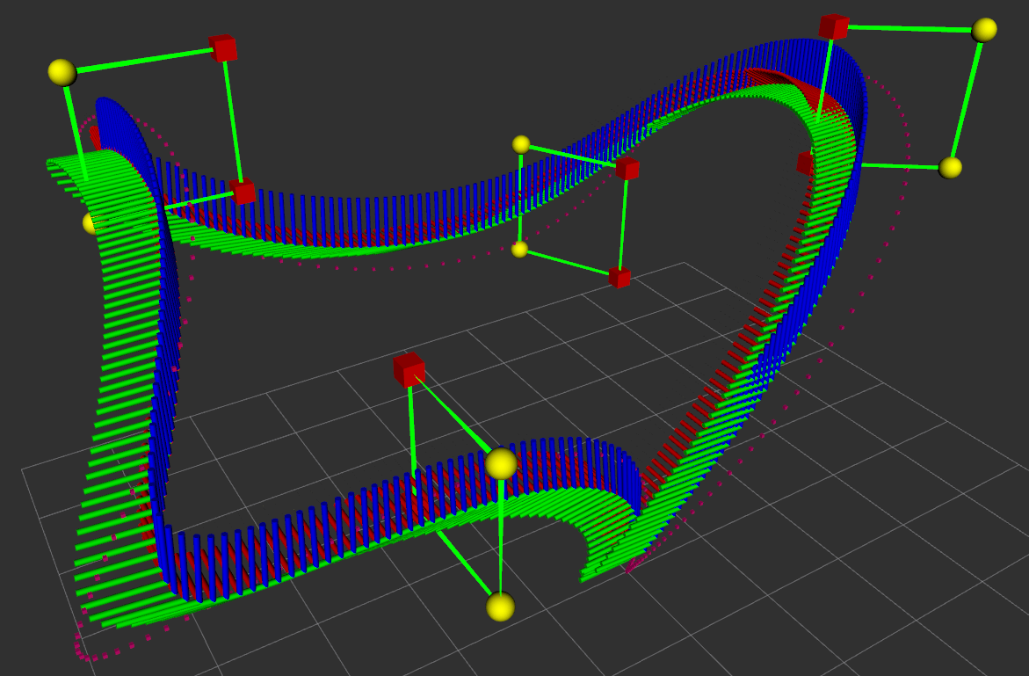
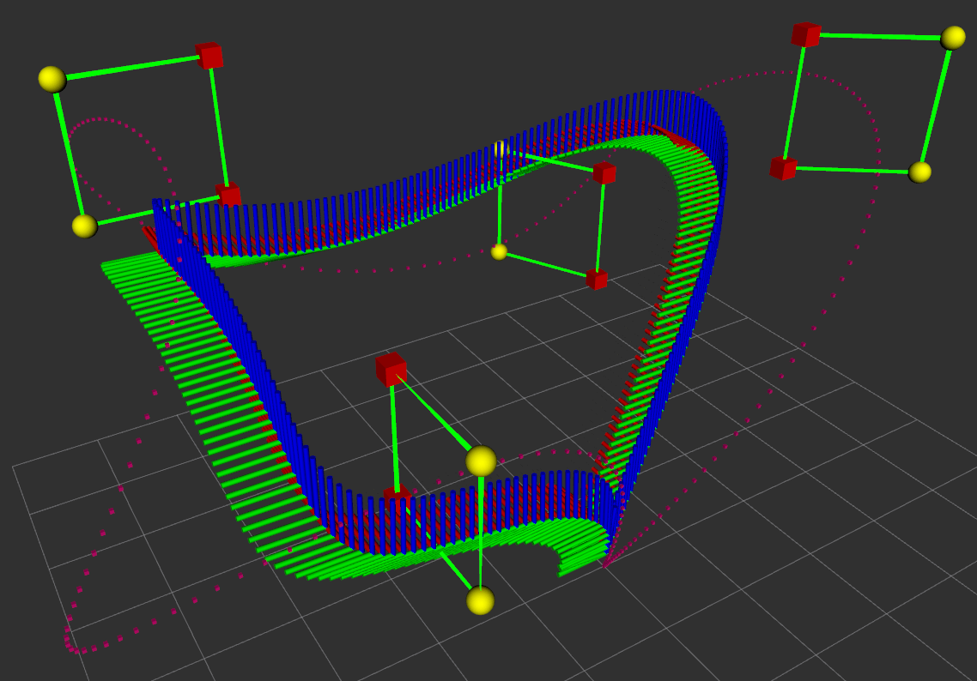
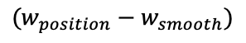
Experimental results
No MPC
(0.75 – 0.25)
$$(w_{position}−w_{smooth})$$
(0.5 – 0.5)
(0.25 – 0.75)
AROB Final Assignment
Alberto Zafra
Daniel Sanz

Slide 6
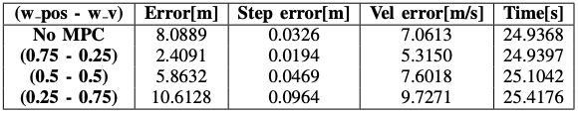
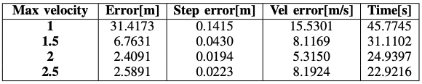
Experimental results
Weights comparison results
Maximum velocities comparison results
AROB Final Assignment
Alberto Zafra
Daniel Sanz

Slide 7
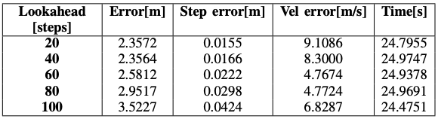
Experimental results
Lookahead steps comparison results
AROB Final Assignment
Alberto Zafra
Daniel Sanz

Slide 8
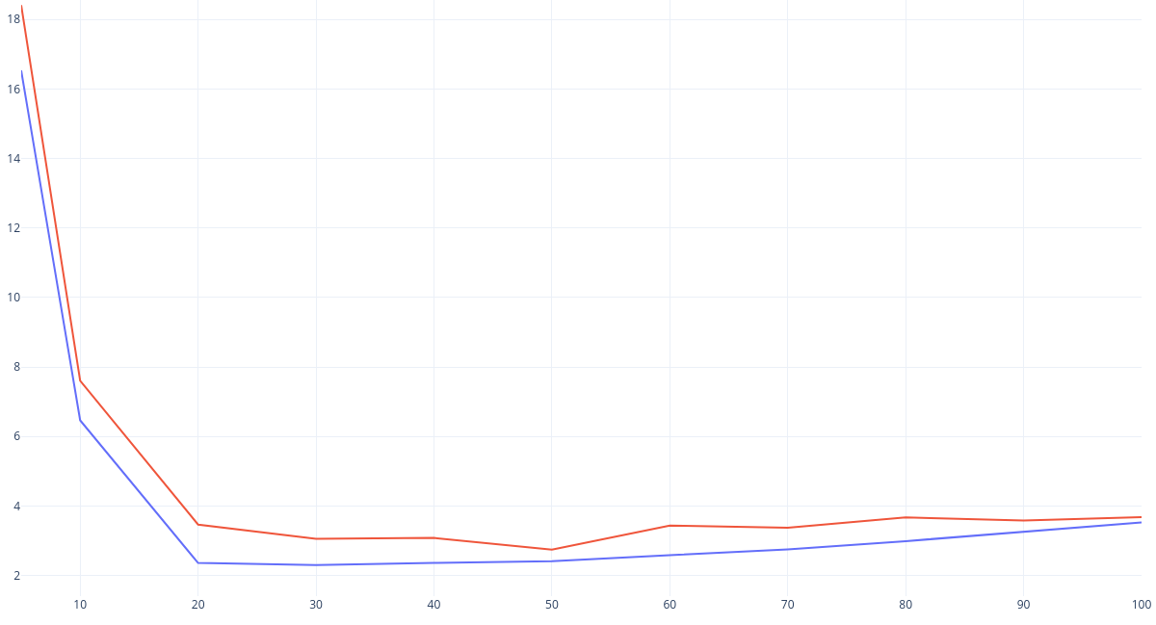

Experimental results
Position error through lookahead timesteps
AROB Final Assignment
Alberto Zafra
Daniel Sanz

Slide 9
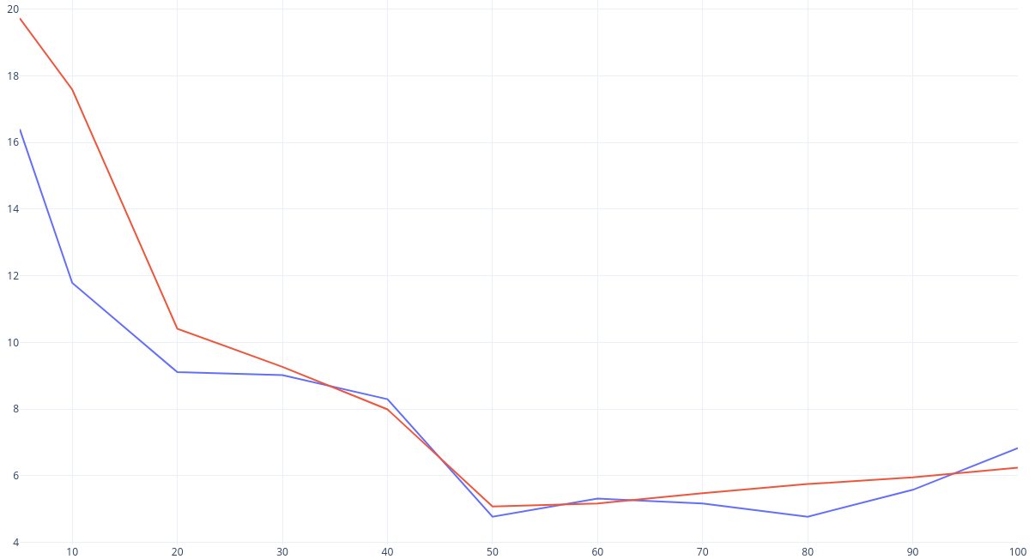
Experimental results
Velocity error through lookahead timesteps
AROB Final Assignment
Alberto Zafra
Daniel Sanz

Slide 10
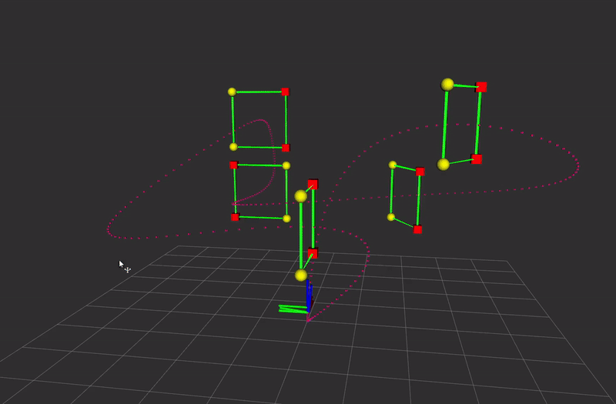
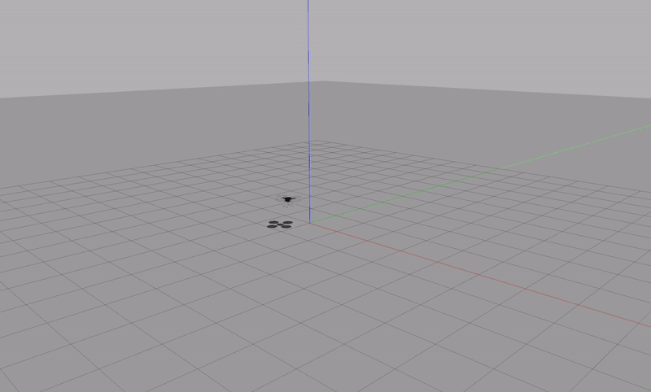
Experimental results
Hard gates circuit simulation (RVIZ)
Hard gates circuit simulation(Gazebo)
AROB Final Assignment
Alberto Zafra
Daniel Sanz

